Slide 1
Smart IOT Door
Presented By
Rakesh Musalay & Priyanka N.Murthy
Spring 2017
University of Massachusetts, Lowell
220 Pawtucket St,Lowell,MA-01854

Slide 2
Outline
Introduction
High level Design Architecture
Technology Stack
Demonstration
Analytics
Conclusion

Slide 3
Introduction
Smart Door – “See who is there from anywhere and lock/unlock the door”
Key Features
Movement detection and visitor alert notifications
Automatic image capture and AWS cloud uploads
Remote access to the door lock

Slide 4
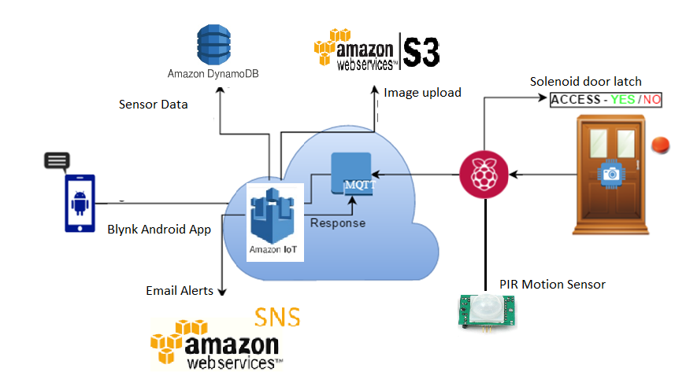
High level Design Architecture [1][2]

Slide 5
Technology Stack
Hardware
Raspberry Pi
PIR Motion sensor
Raspberry pi -Camera Module
Relay switch
Solenoid door latch
Software
AWS IoT framework
AWS Dynamo DB
AWS S3
AWS SNS
Blynk IOT App
Motion Libraries -Camera

Slide 6
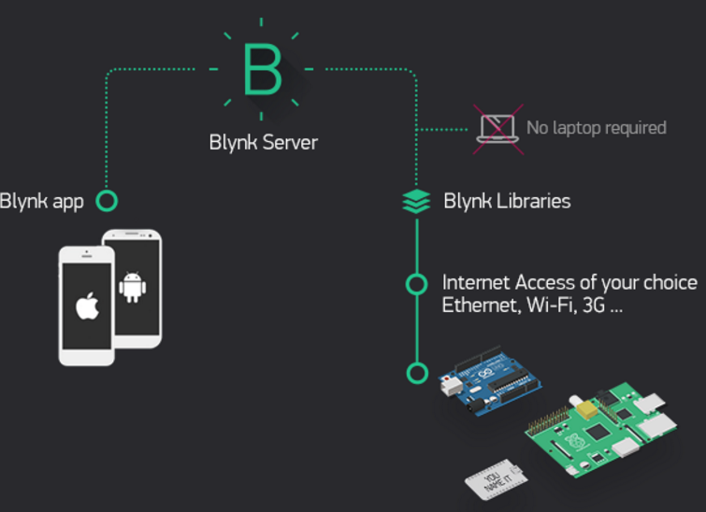
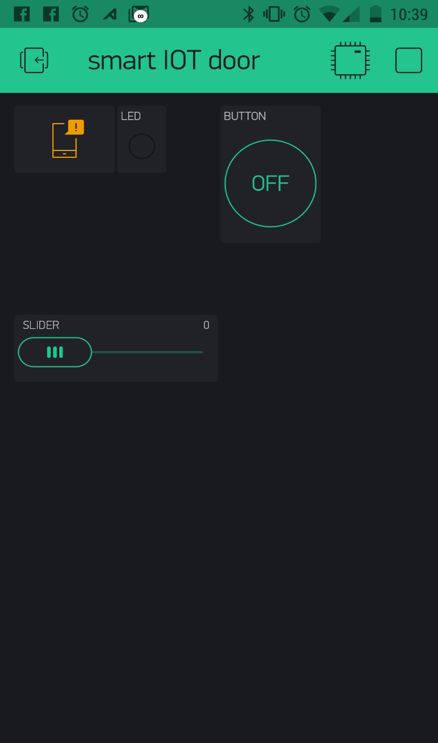
Blynk IOT App Dashboard[3]

Slide 7
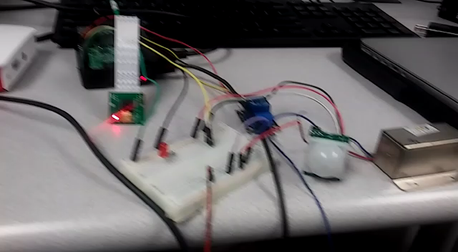
Demonstration

Slide 8
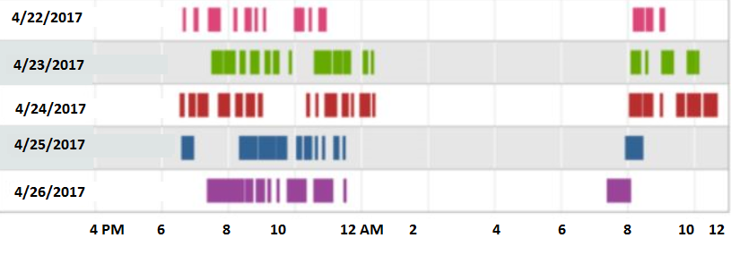
Analytics - Motion sensor data

Slide 9
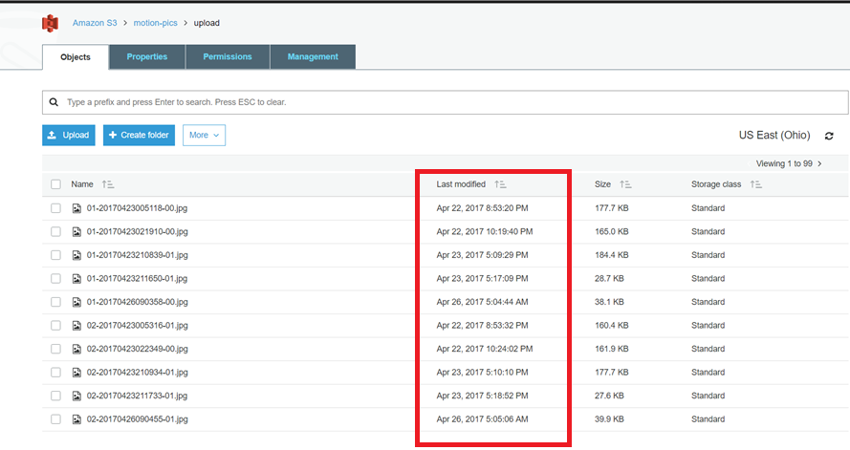
AWS S3 Bucket

Slide 10
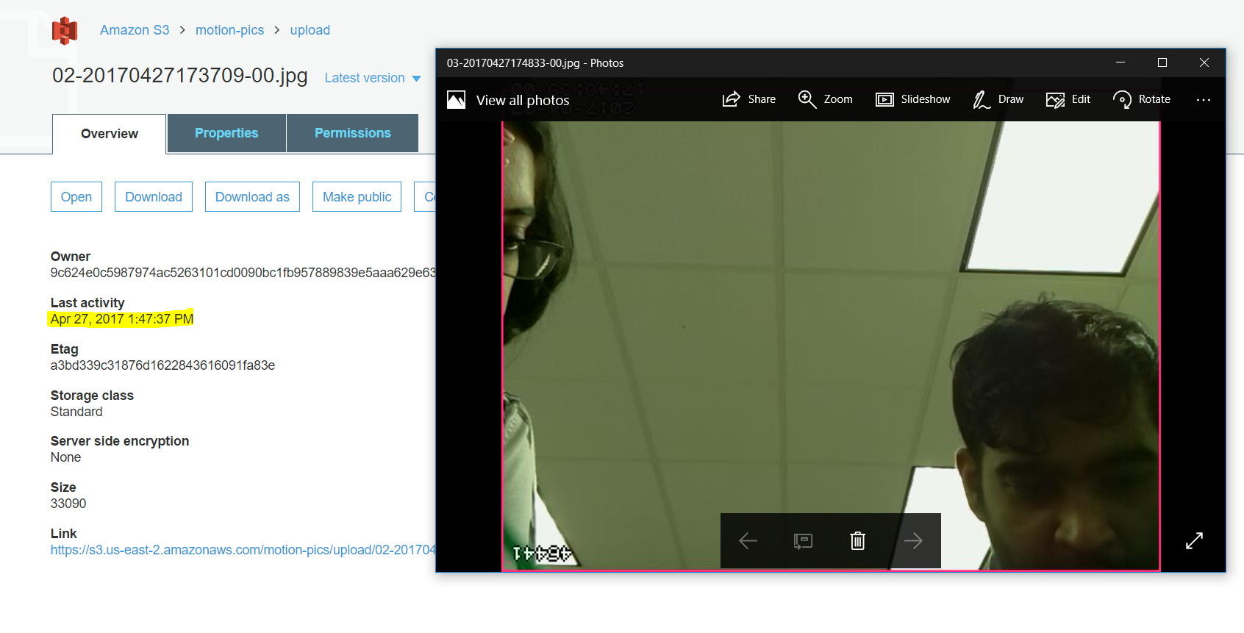
AWS S3 Bucket

Slide 11
Conclusion
Implemented IOT enabled prototype for keyless door entry
Enhanced security with motion detection and image uploads to the cloud
Possible Enhancements
Alexa Voice service
Facial recognition using Amazon Rekognition

Slide 12
References
[1] AWS IOT http://docs.aws.amazon.com/iot/latest/developerguide/iot-gs.html
[2] AWS S3
http://docs.aws.amazon.com/AmazonS3/latest/gsg/GetStartedWithS3.html
[3] Blynk Server and APP
http://docs.blynk.cc/

Slide 13
Thank you

